Slide 1
Supercharger and EV Analysis
A group project for visualization of supercharger stations in California
and current state of EV populations and the latest Tesla models
By
Charissa Hoxie Toshi Torihara Michael Farm

Slide 2
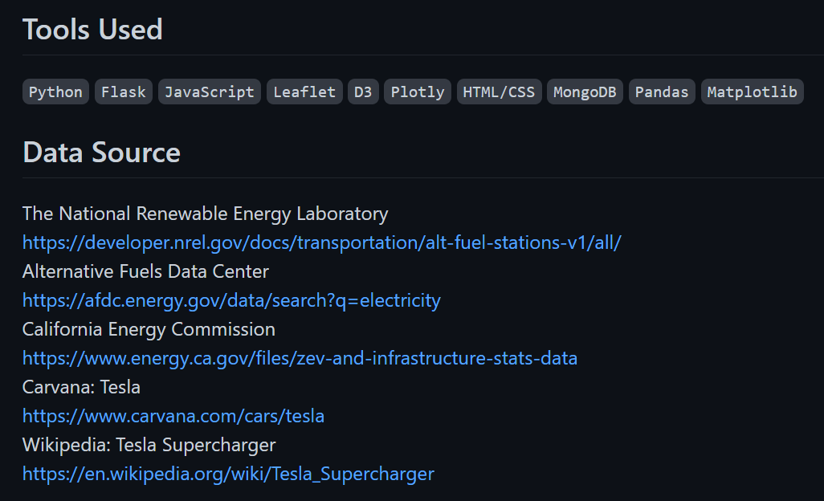

Slide 3
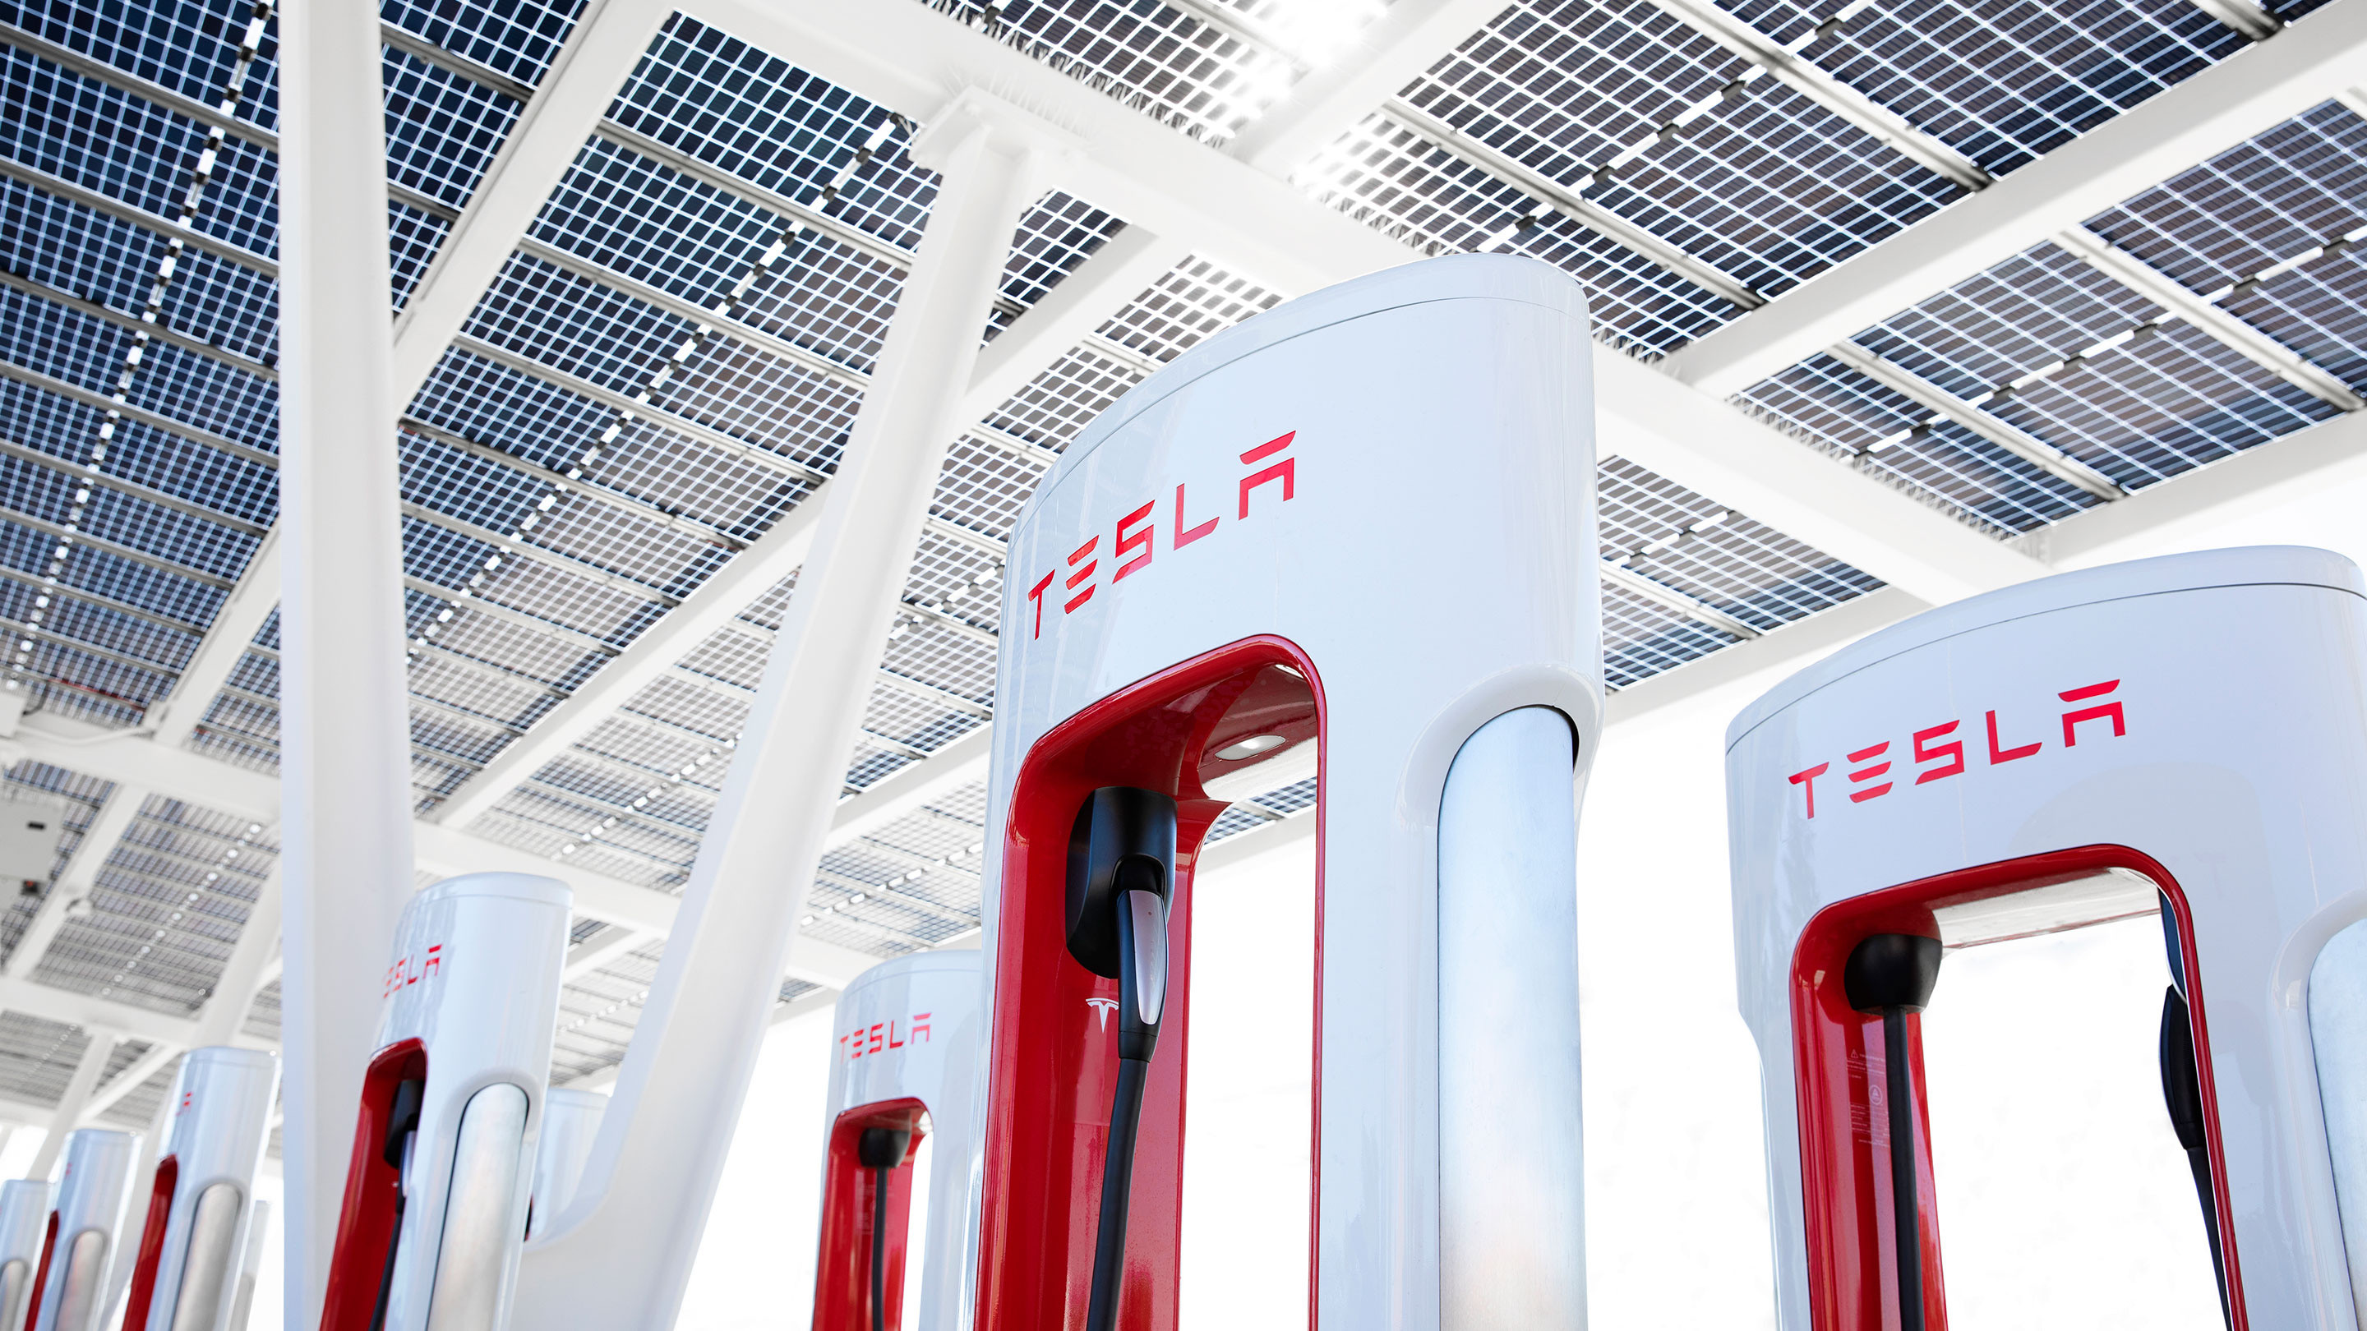
Extract, Transform, Load (ETL) Phase

Slide 4
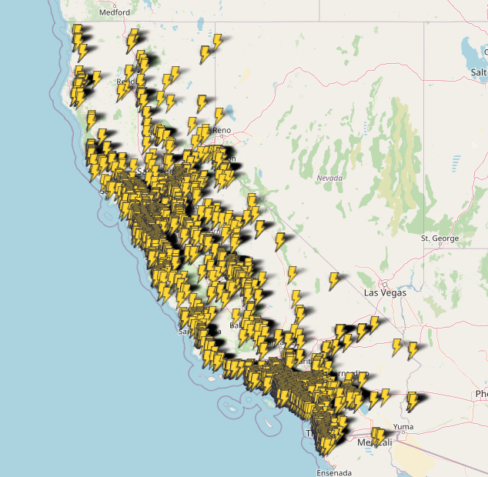
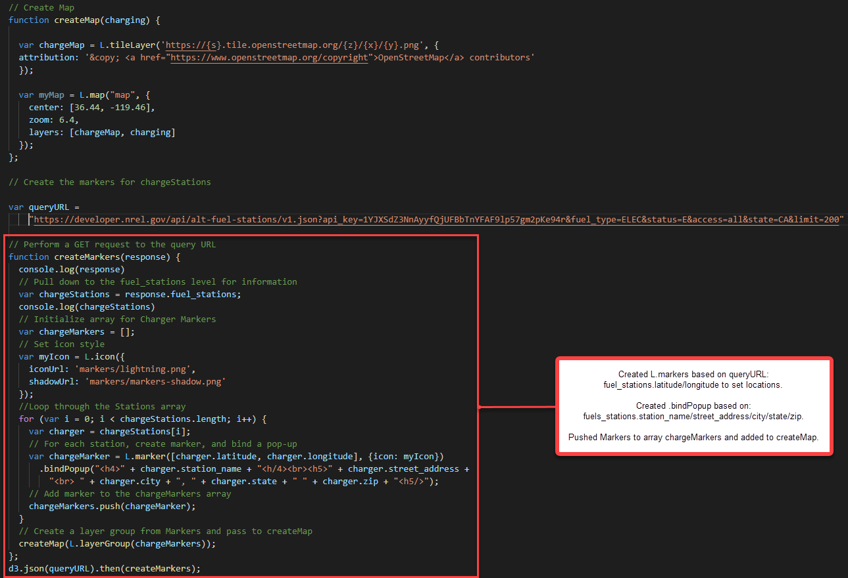
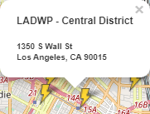
Interactive Map of Available EV Charging Stations in California

Slide 5
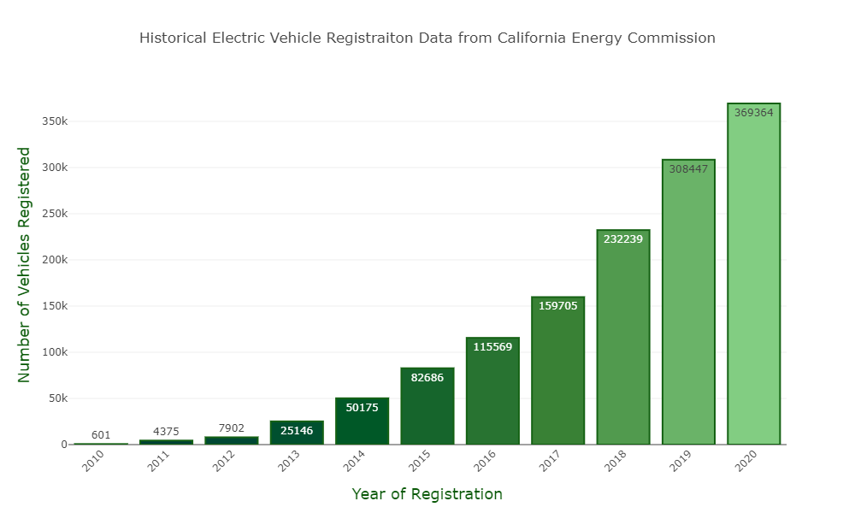
Chart of Electronic Vehicles Registered in California for 2010 - 2020

Slide 6
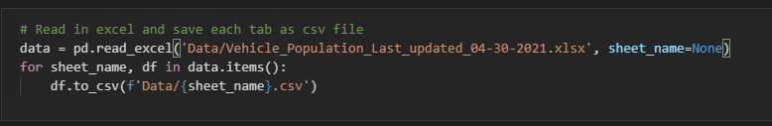
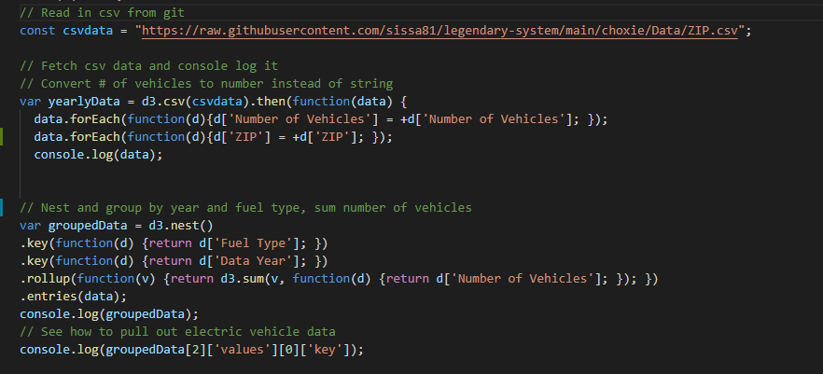
data.ipynb / ev_population.js

Slide 7
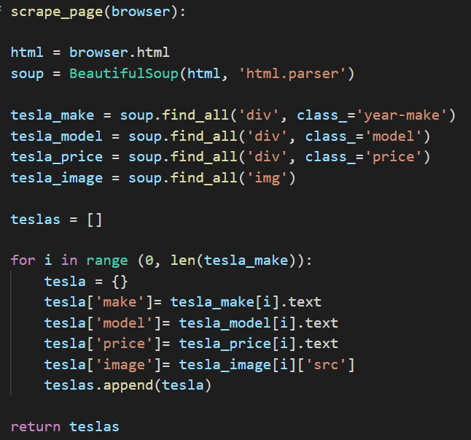
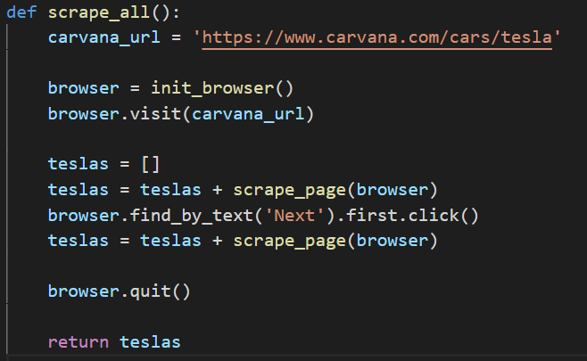
Web-scraping Functions
Using Splinter, get information of Tesla models by web-scraping off of Carvana site. Created functions as below.
scrape_page(browser): Using BeautifulSoup and ‘find_all’ function to extract the make, model, price, and images of Teslas
scrape_all(): Further look into next page by ‘find_by_text’ and repeat ‘scrape_page(browser)’

Slide 8
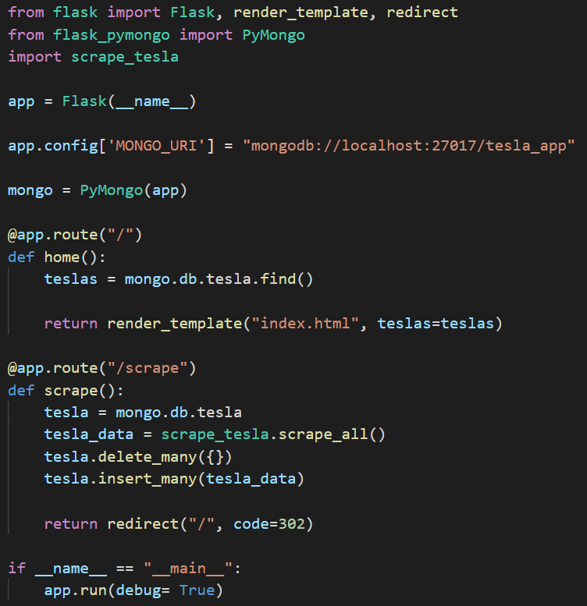
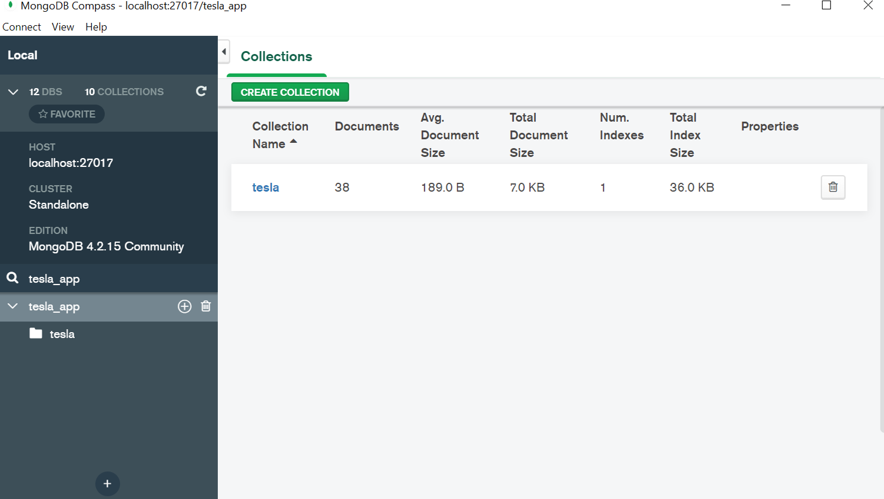
Flask App and connection with MongoDB
Using Flask/PyMongo to store extracted Tesla data and connect to a MongoDB database named tesla_app

Slide 9
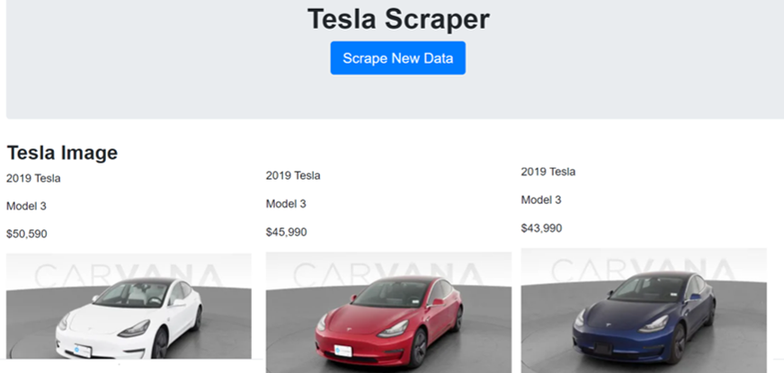
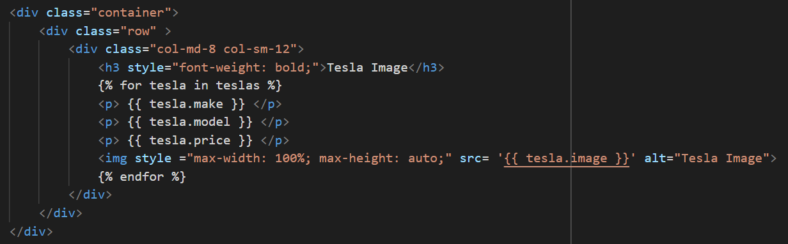
Tesla Scraper HTML with connection to app.py
Create HTML with connection to app.py to generate Tesla Scraper to display all the data

Slide 10
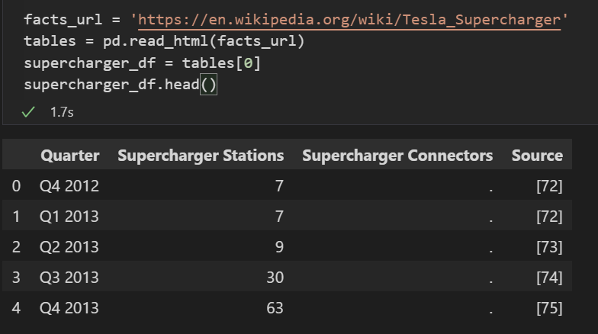
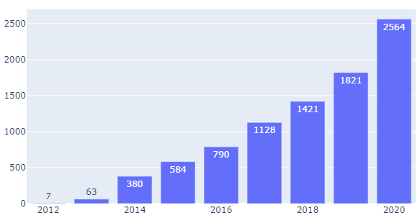
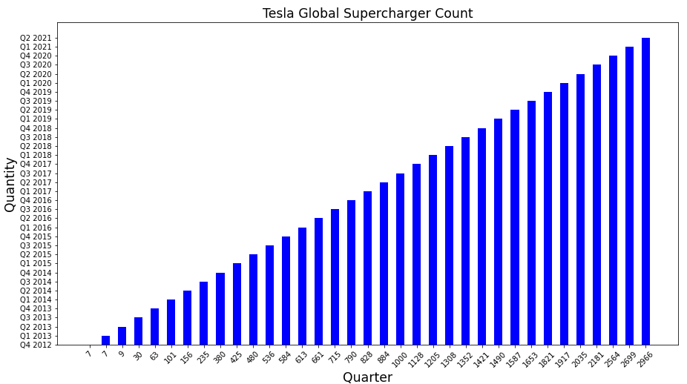
Extra Visualization with scraped data table from Wikipedia (Tesla_Supercharger)
Tesla Global Supercharger Count
Quantity
Year
Created bar chart by converting matplotlib.pyplot to plotly.graph_object

